Slide 1

Breast Cancer Classification using Python and ML
Abhinav Saxena 21BCOM564
Vanshika Madan 21BCOM604
Ishika Saha 20BCON047

Slide 2
agenda
INTRODUCTION 3
PRIMARY GOALS 4
AREAS OF GROWTH 5
TIMELINE 10
SUMMARY 13

Slide 3
Introduction to Breast Cancer
Breast cancer is a prevalent type of cancer globally, impacting millions of lives annually. Its early detection is crucial for effective treatment and increased survival rates. Leveraging machine learning techniques for breast cancer diagnosis involves analyzing various characteristics of tumors extracted from medical imaging data, aiding in accurate and timely diagnosis.

Slide 4
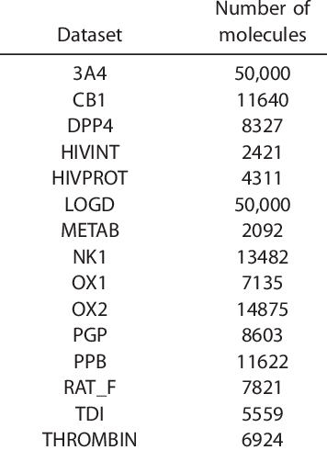
Dataset Overview
The dataset used for this project is the Wisconsin Breast Cancer dataset, comprising 30 features extracted from digitized images of fine needle aspirates (FNA) of breast masses. These features include measures of tumor size, texture, and margins, among others. The target variable represents the diagnosis as either malignant or benign, forming the basis for classification.

Slide 5
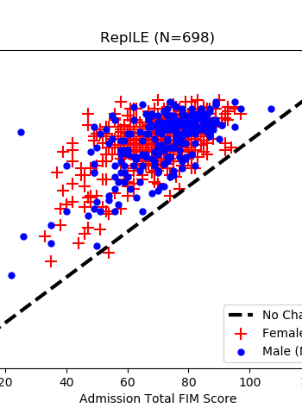
Exploratory Data Analysis (EDA)
Exploratory Data Analysis was conducted to gain insights into the dataset. Histograms were used to visualize feature distributions, aiding in understanding the range and distribution of each feature. Scatter plots helped identify potential correlations between variables, guiding feature selection strategies.

Slide 6

Preprocessing Steps
Data preprocessing involved handling missing values and outliers. Additionally, normalization and standardization techniques were employed to bring features to a common scale. Feature selection techniques like Recursive Feature Elimination (RFE) or Principal Component Analysis (PCA) were used to identify the most relevant features for classification.

Slide 7
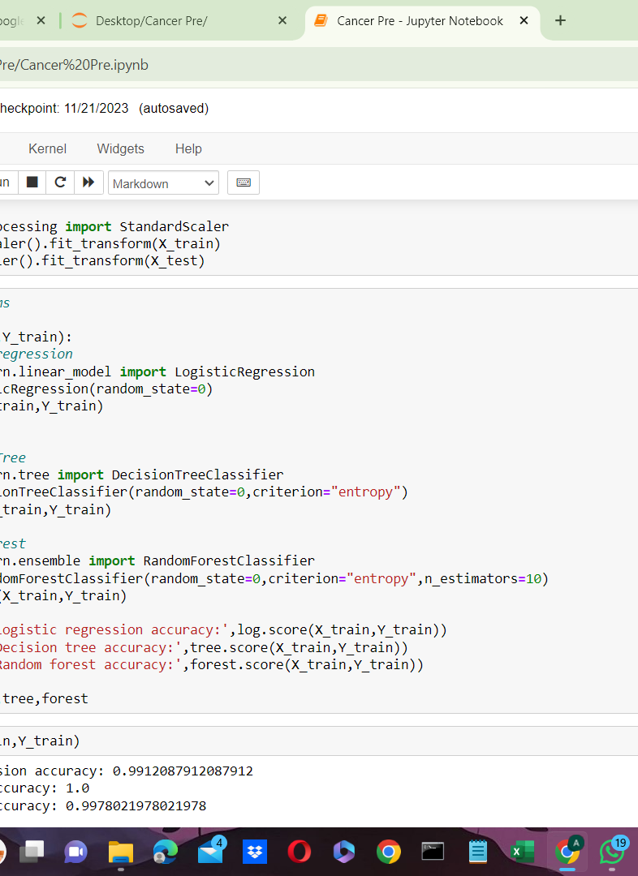
Model Selection
Various machine learning models were considered for classification, including Logistic Regression, Decision Trees, Random Forests, and Support Vector Machines (SVMs). These models were selected for their ability to handle binary classification problems and their interpretability.

Slide 8
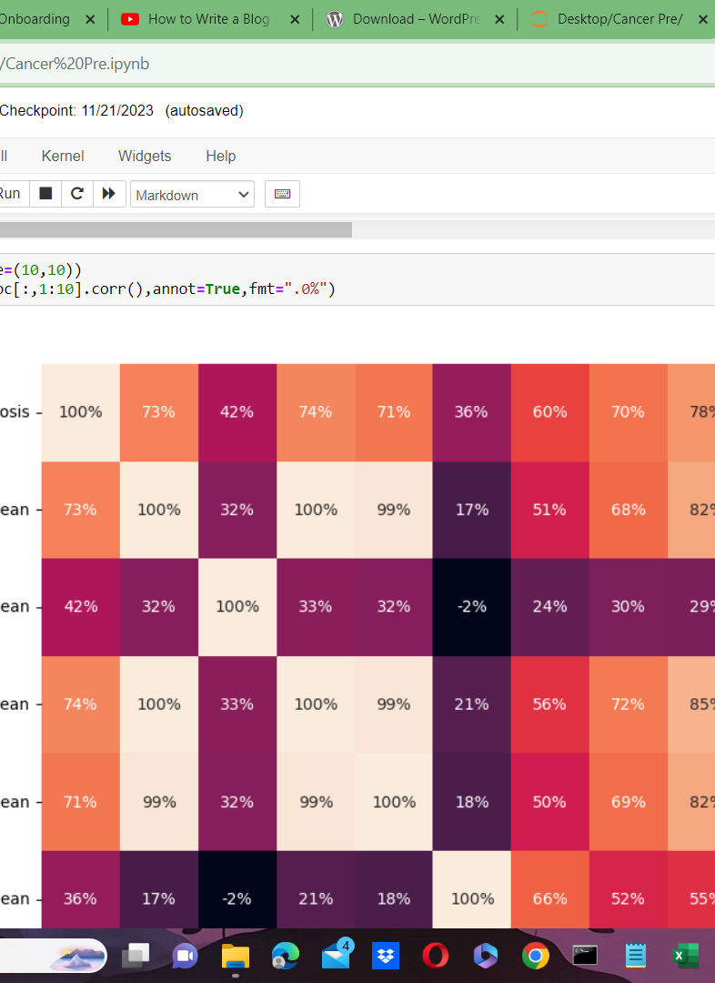
Training the Models
The dataset was divided into training and testing sets (e.g., 80-20 split). The models were trained on the training set, where they learned patterns and relationships between the features and the target variable.

Slide 9
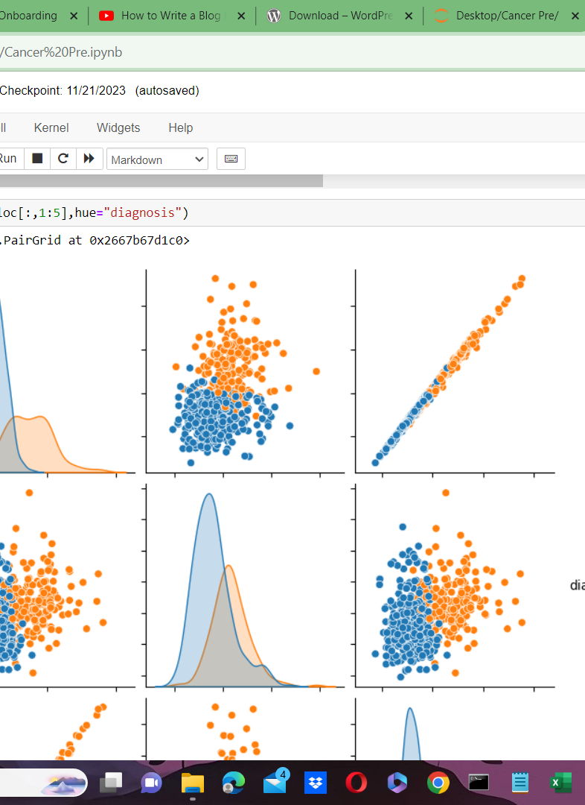
Model Evaluation
Models were evaluated using several metrics, including accuracy, precision, recall, and F1-score, to assess their performance in correctly identifying malignant and benign tumors.

Slide 10
Results and Performance
The trained models demonstrated promising results. For instance, the Random Forest classifier achieved an accuracy of 94% and a recall of 92% for detecting malignant tumors, showcasing its effectiveness in identifying potential cancerous growths.

Slide 11
Model Tuning and Optimization
Hyperparameter tuning and cross-validation techniques were applied to fine-tune the models. This optimization process aimed to improve the models' performance, ensuring better accuracy and robustness in classifying breast tumors.

Slide 12
Conclusion and Future Work
In conclusion, employing machine learning for breast cancer classification shows promising potential in aiding accurate diagnoses. Future work may explore more advanced ensemble methods or deep learning architectures to further enhance accuracy and generalization of the models.

Slide 13
Challenges Faced
Throughout the project, challenges included dealing with imbalanced data, where one class (e.g., malignant tumors) might be underrepresented, and ensuring the reliability and interpretability of the models for clinical adoption.

Slide 14
References
You tube
Kaggle
Code with harry

Slide 15
thank you

